Slide 1
CS120 Project Tutorial
Yihui Yan
Fall 2021

Slide 2
First of All
https://github.com/SIST1C407/ATNet/
Ask for help.
View tutorial.
Contribute to the wiki.

Slide 3



Overview
Build a acoustic toy network(ATNet). Each layer is built upon the former layer.
Project 1: Physical Layer
Project 2: MAC Layer
Project 3: TCP/IP Layer
Project 4: Application Layer
Internet
gateway
Internet
gateway
FTP Server

Slide 4
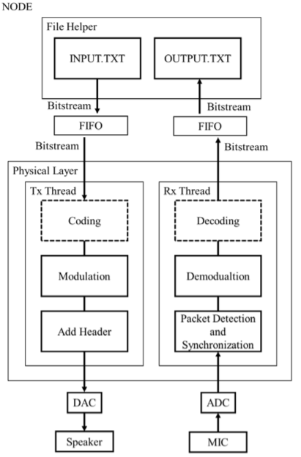

Project 1 Acoustic Link
Project 1 is the basis of ATNet, parameters in project 1 are very important when you are facing some magic problems.
Recommended tools
JUCE & Projucer (C++):
get rid of some annoying work (e.g. multi-thread for speaker and mic)
Windows OS:
sound card may give bad performance in MacOS
You can also use other languages (e.g. Python and Java).

Slide 5
Play with the Sound Card
Recommended Tools for Windows
(https://github.com/SIST1C407/ATNet/blob/main/doc/01_win_asio_juce)
Microsoft Visual Studio
ASIO Driver and SDK
JUCE Library and Projucer
Use the Tools
(https://github.com/SIST1C407/ATNet/tree/main/doc/02_write_a_player)

Slide 6
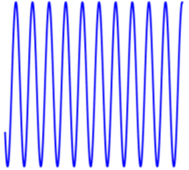
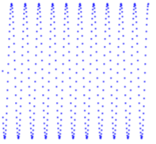
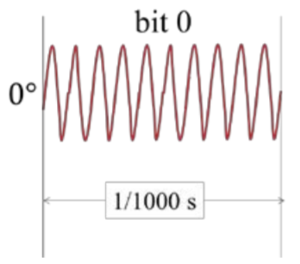
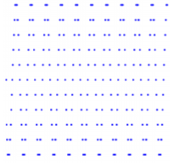
Basic Signal Knowledge
Sample rate: number of samples of signal per second
Bit depth: quantization fineness of the signal
Bit rate: number of bits per second
Carrier wave rate: cycles of carrier wave per second
1s: 10000 carrier waves, 1000 bits
-> 1 bit uses 10 carrier wave

Slide 7




Modulation and Demodulation
Modulation
Vary a carrier wave to transmit data
Use carrier wave to represent 0 and 1
Check Lec 3 for more details
Demodulation
Use correlation
Sample 0 * carrier wave > 0
Sample 1 * carrier wave < 0 (PSK)
But the threshold may not be 0
0
ASK 1
FSK 1
PSK 1(recommended)

Slide 8
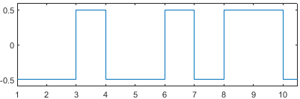
Modulation and Demodulation (Example 1)
Modulation
1 -> [0.5] v (high), 0 -> [-0.5] v (low)
Demodulation
Sample * [0.5] > 0 -> 1
Sample * [0.5] < 0 -> 0
0
0
1
0
0
1
0
1
1
0

Slide 9
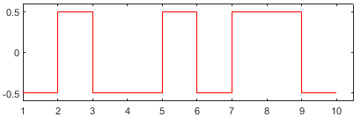
Modulation and Demodulation (Example 1)
Modulation
1 -> [0.5] v (high), 0 -> [-0.5] v (low)
Demodulation
Sample * [0.5] > 0 -> 1
Sample * [0.5] < 0 -> 0
0
0
1
0
0
1
0
1
1
0
When a sample is lost
0
1
0
0
1
0
1
1
0
?

Slide 10
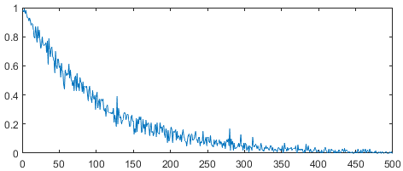
Modulation and Demodulation (Example 1)
Modulation
1 -> [0.5] v (high), 0 -> [-0.5] v (low)
Demodulation
Sample * [0.5] > 0 -> 1
Sample * [0.5] < 0 -> 0
0
0
1
0
0
1
0
1
1
0
When a sample is lost
0
1
0
0
1
0
1
1
0
?
Accuracy (%)
Sample Loss Rate: 1%
Frame Length (bits)

Slide 11
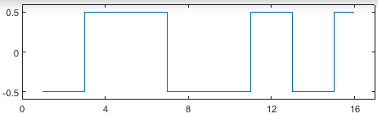
Modulation and Demodulation (Example 2)
0
1
0
0
Modulation
1 -> [0.5 0.5 -0.5 -0.5] v (high high low low)
0 -> [-0.5 -0.5 0.5 0.5] v (low low high high)
Demodulation
Sample * [0.5 0.5 -0.5 -0.5] > 0 -> 1
Sample * [0.5 0.5 -0.5 -0.5] < 0 -> 0

Slide 12
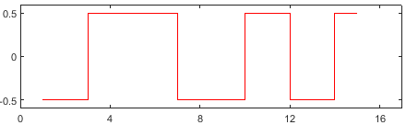
Modulation and Demodulation (Example 2)
0
1
0
0
Modulation
1 -> [0.5 0.5 -0.5 -0.5] v (high high low low)
0 -> [-0.5 -0.5 0.5 0.5] v (low low high high)
Demodulation
Sample * [0.5 0.5 -0.5 -0.5] > 0 -> 1
Sample * [0.5 0.5 -0.5 -0.5] < 0 -> 0
When a sample is lost
0
1
?
?

Slide 13
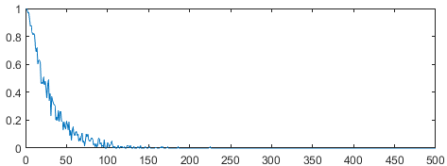
Modulation and Demodulation (Example 2)
0
1
0
0
Modulation
1 -> [0.5 0.5 -0.5 -0.5] v (high high low low)
0 -> [-0.5 -0.5 0.5 0.5] v (low low high high)
Demodulation
Sample * [0.5 0.5 -0.5 -0.5] > 0 -> 1
Sample * [0.5 0.5 -0.5 -0.5] < 0 -> 0
When a sample is lost
0
1
?
?
Accuracy (%)
Sample Loss Rate: 1%
Frame Length (bits)

Slide 14
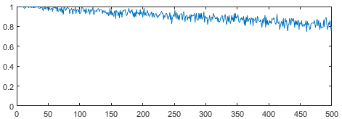
Modulation and Demodulation (Example 2)
0
1
0
0
Modulation
1 -> [0.5 0.5 -0.5 -0.5] v (high high low low)
0 -> [-0.5 -0.5 0.5 0.5] v (low low high high)
Demodulation
Insert some samples heuristically
Sample * [0.5 0.5 -0.5 -0.5] > 0 -> 1
Sample * [0.5 0.5 -0.5 -0.5] < 0 -> 0
When a sample is lost
0
1
?
?
Accuracy (%)
Sample Loss Rate: 1%
Insert -0.5 v
Frame Length (bits)

Slide 15
Modulation and Demodulation
One more question
With the same loss rate, is a 100% accurate scheme better than a 90% accurate scheme?
For project 1, the answer may be YES.
For project 2-4, the answer may be NO.

Slide 16
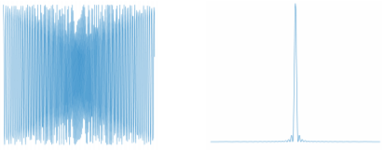
Header and Frame Detection
Header
Help receiver to find out the accurate start of a frame.
Just add a predefined wave pattern before your data.
Select a signal with good autocorrelation.
Frame detection and synchronization
When receiving enough samples, do correlation between header and received samples to determine whether there is something transmitting.
Once the occurrence of a new frame is confirmed, synchronize the header and find the start of the frame.

Slide 17
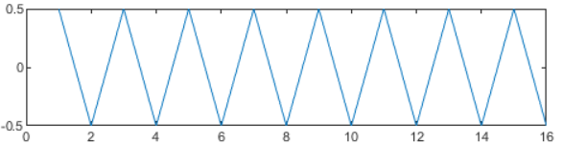
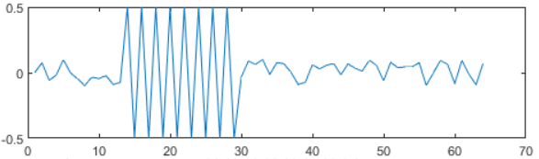
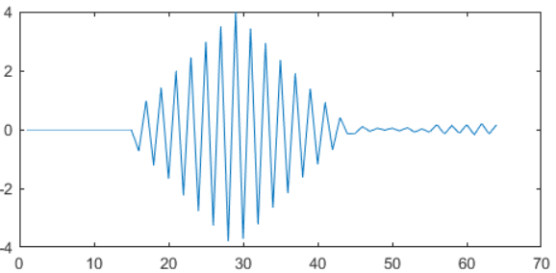
Header and Frame Detection (Example)
Header
Received Samples
Correlation

Slide 18
Header and Frame Detection (Example)
Header
Received Samples
Correlation

Slide 19
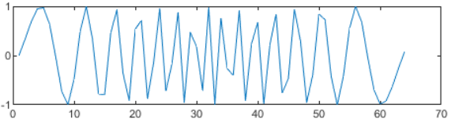
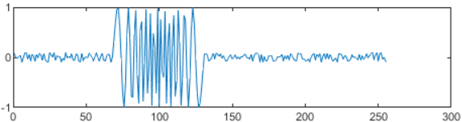
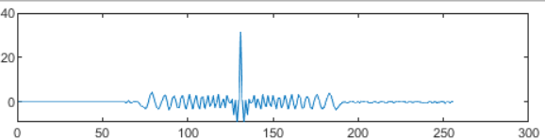
Header and Frame Detection (Example)
Header
Received Samples
Correlation

Slide 20
Header and Frame Detection (Example)
Header
Received Samples
Correlation

Slide 21
Header and Frame Detection (Example)
Header
Received Samples
Which one is a better header?
Correlation

Slide 22
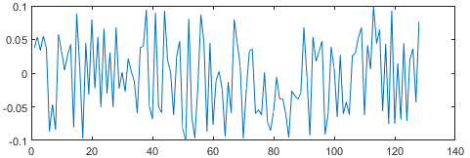
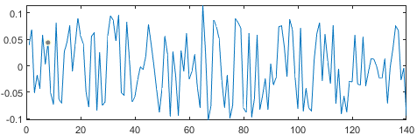
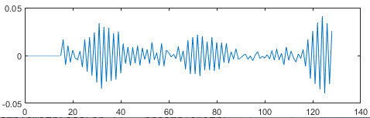
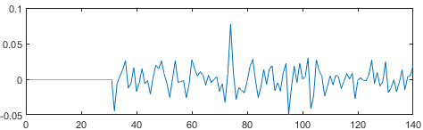
Header and Frame Detection (Example)
Header
Received Samples
Correlation

Slide 23
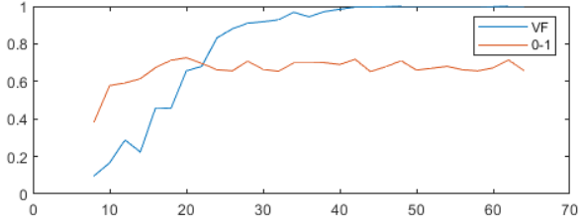
Header and Frame Detection (Example)
Header
Accuracy (%)
Sample Loss Rate: 0%
Header Length (Samples)

Slide 24
Header and Frame Detection (Example)
Header
Accuracy (%)
?
The longer the header is
The better the synchronization is
Header Length (Samples)

Slide 25
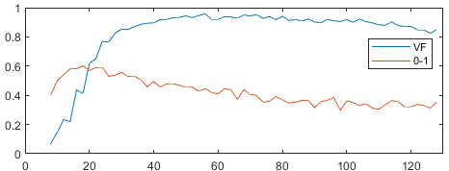
Header and Frame Detection
Noise and Loss
The index of max correlation sum may be not exactly the end of the preamble. The deviation should be within the tolerance of modulation scheme.
Accuracy (%)
Accuracy (%)
Sample Loss Rate: 0%
Sample Loss Rate: 1%
Header Length (Samples)
Header Length (Samples)

Slide 26


Practical Issue for Project 1
Find a balance between time (<15s) and accuracy (>99%).
Each frame contains a header, the longer the frame is, the shorter the total length is, the less time you use.
However, long frame is easy to occur error. The ADC/ DAC rates of different devices are slightly different (i.e. frequency offset).
Speaker needs time to warm up, do not use short header.
code
modulate
add header
file
010100101
sound
decode
demodulate
synchronize

Slide 27
Practical Issue for Project 1
Project Checkpoints:
Time, Accuracy
Channel State:
Sample Loss Rate, Noise Scale
Your Design:
Amplitude
Header: Pattern, Length
Data: Pattern, Length (Samples Per Bit, Bits Per Frame)
code
modulate
add header
file
010100101
sound
decode
demodulate
synchronize

Slide 28
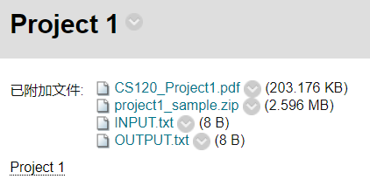
Sample Code!
sample code for Matlab

Slide 29
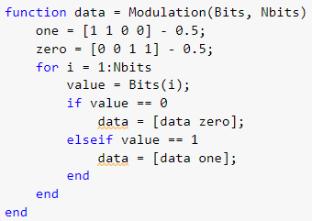
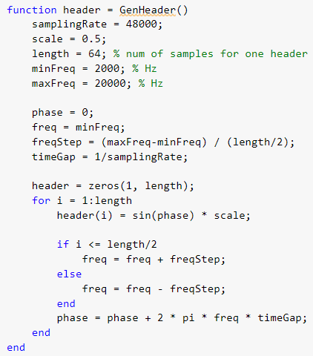
Modulation
Generate
Header
Frame = [header data];

Slide 30
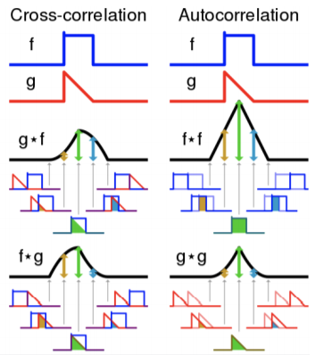
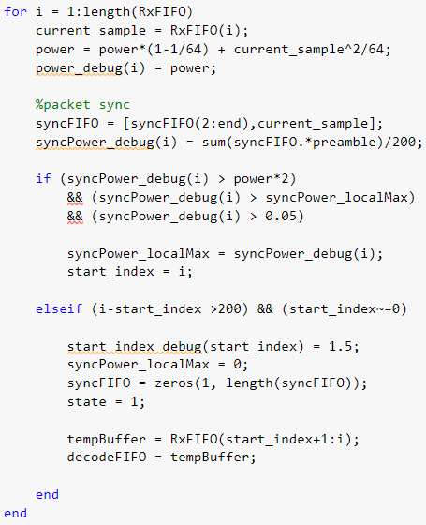
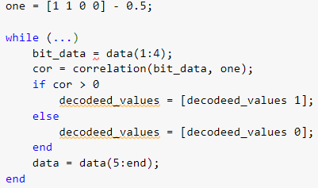
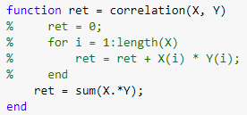
Correlation
Frame Detection
Demodulation

Slide 31
Project 1 Check
Deadline: Oct.17 afternoon
Each group has around 10 minutes, show your checkpoints to TAs and gain corresponding points.
After check, submit your code to Blackboard on the spot. You can only submit once.
I’ll send the time arrangement before deadline to you.

Slide 32
QUIZ

